Slide 1
Encryption in Azure
PRESENTER NAME
(Updated 3/2023)

Slide 2
Encryption In Azure
General Terminology
Encryption System Components
Envelop Encryption
Azure Terminology
Azure Key Vault
Azure Storage Encryption
Azure Virtual Machine Encryption

Slide 3
General Terminology
Encryption
Cryptographic transformation of plain text to cipher text to prevent anyone but intended recipient from reading the data
Encryption-at-rest
Encryption for data that is being stored on a device
Encryption-in-transit
Encryption of data while it moves across a network
Key Encryption Key (KEK)
Asymmetric key used to wrap other symmetric keys used by applications
Data Encryption Key (DEK)
Symmetric key used to encrypt data

Slide 4
General Terminology
Platform Managed Key (PMK)
Cloud Service Provider (CSP) manages the access and lifecycle of the key
Customer Managed Key (CMK)
Customer manages the access and lifecycle of the key
Double Encryption
Encryption of data with multiple encryption algorithms to mitigate the risk of loss of confidentiality due to the compromise of a single encryption algorithm
Hardware Security Module (HSM)
Physical computing device that provides tamper-evident and intrusion-resistant safeguarding and management of digital key sand other secrets, as well as crypto-processing
National Institute of Standard and Technology (NIST)
US government agency whose mission is to set a variety of standards including security standards
Federal Information Processing Standard (FIPS 140-2)
NIST publication that specifies the security requirements that will be satisfied by a cryptographic module. Includes four levels with increasing security requirements per each level.
Notes:
FIPS 140-2 (https://csrc.nist.gov/publications/detail/fips/140/2/final)

Slide 5
Encryption System Components
Data
The objects to encrypt
Encryption Engine
The component that handles the encryption and decryption operations
Key Management Solution
The component that handles the key and passes them to the encryption engine

Slide 6
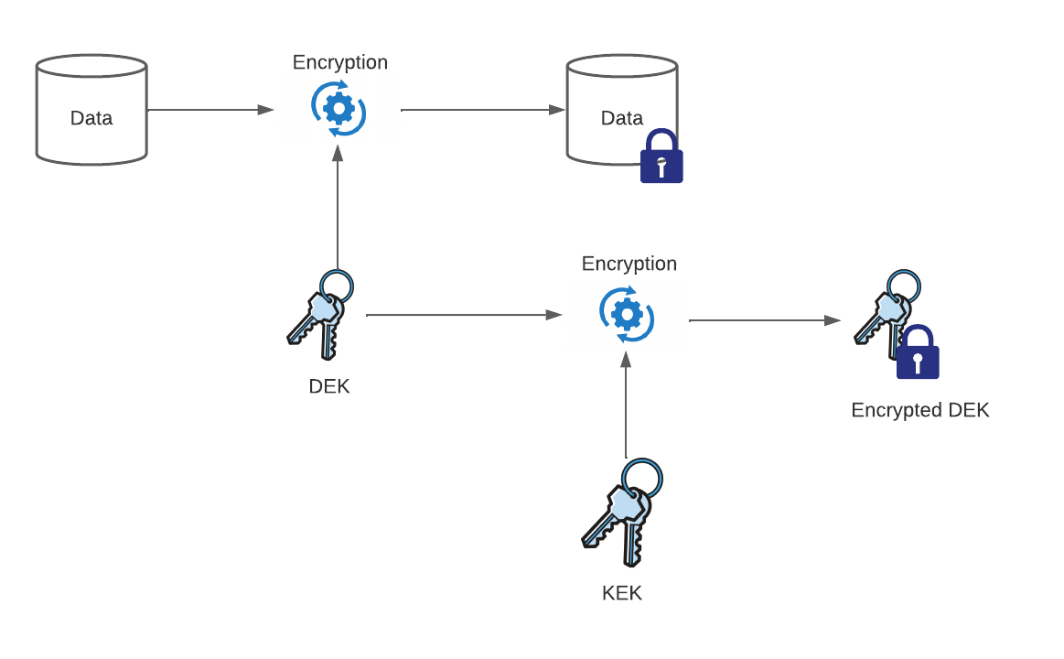
Envelop Encryption

Slide 7
Azure Terminology
Azure Storage Account
Atomic unit of storage in Azure providing a unique namespace for data objects including blobs, file shares, queues, tables, and disks
Account Encryption Key (AEK)
Symmetric key that is generated for each storage account and is used to create DEKs for objects stored within the storage account and is wrapped by either a PMK or CMK
Azure Key Vault
Key management solution used to securely store secrets, keys, and certificates

Slide 8
Azure Terminology
BitLocker
Full disk encryption system available in Windows operating system
DMCrypt
Full disk encryption system available in some Linux distributions

Slide 9
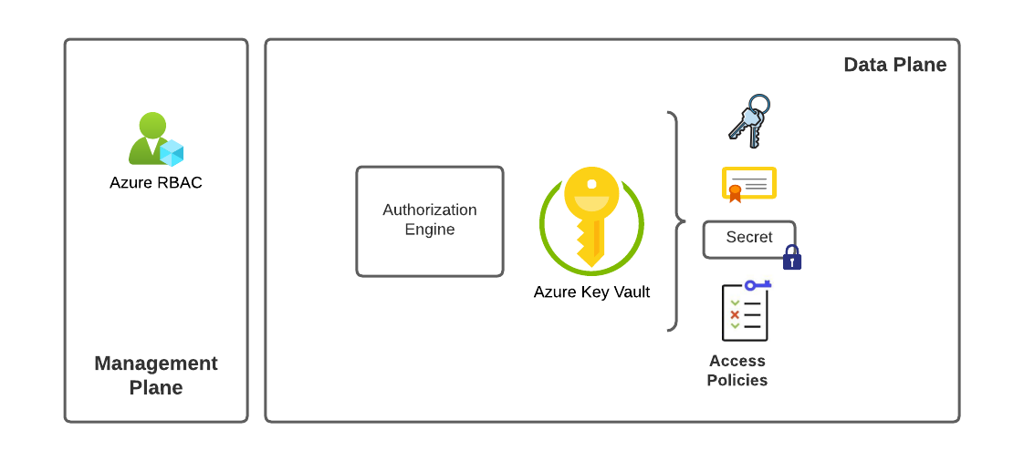
Azure Key Vault - Architecture
Notes:
Authorization Engine by default uses local access policies for data-plane operations which are course-grained and allow a set of actions across all secrets, certificates, and keys. Alternatively, can be configured to use Azure RBAC for both management-plane and data-plane activities which allow for more granular authorization of individual keys, certificates, and secrets. (https://learn.microsoft.com/en-us/azure/key-vault/general/rbac-guide)
Note that Key Vaults have specific API limits which can be reached if a single Key Vault is used by too many workloads or applications (https://learn.microsoft.com/en-us/azure/key-vault/general/overview-throttling)

Slide 10
Azure Key Vault – Standard vs Premium SKU
Standard SKU uses software inside Azure-service virtual machines to perform cryptographic operations
Premium SKU uses HSMs to perform cryptographic operations
Standard SKU is compliant with FIPS 140-2 Level 1
Premium SKU is compliant with FIPS 140-2 Level 2
Both Standard and Premium SKU store the keys on the HSM while at rest
Notes:
Anything beyond level 2 will require a dedicated HSM (https://learn.microsoft.com/en-us/azure/dedicated-hsm/overview)

Slide 11
Azure Key Vault – Security Features
General
Soft delete providing recovery of deleted Key Vaults and Key Vault objects
Support for BYOK
Purge protection
Authentication and Authorization
Supports Azure AD for authentication
Supports Azure RBAC or local Access Policies for authorization
Network
Support for Private Endpoints and Service Endpoints
Logging
Integration with Event Grid for streaming notifications
Logging of management-plane events in Azure Activity Logs and data-plane events via diagnostic logging
Key Vault Insights
Availability
Key Vaults are replicated within region and across to paired regions*
Regions that support paired region replication provides native failover but without an SLA
Supports backup and restore of individual keys, secrets, and certificates across Key Vaults within the same geo-political region
* Some regions do not support this (https://learn.microsoft.com/en-us/azure/key-vault/general/disaster-recovery-guidance)
Notes:
Soft delete is enabled by default on all new Key Vaults (https://learn.microsoft.com/en-us/azure/key-vault/general/soft-delete-overview)
Event Grid events include expiration of keys and modification of access policies (https://learn.microsoft.com/en-us/azure/event-grid/event-schema-key-vault?tabs=event-grid-event-schema)
Logging (https://learn.microsoft.com/en-us/azure/key-vault/general/logging)
Key Vault Failover - https://learn.microsoft.com/en-us/azure/key-vault/general/disaster-recovery-guidance#failover

Slide 12
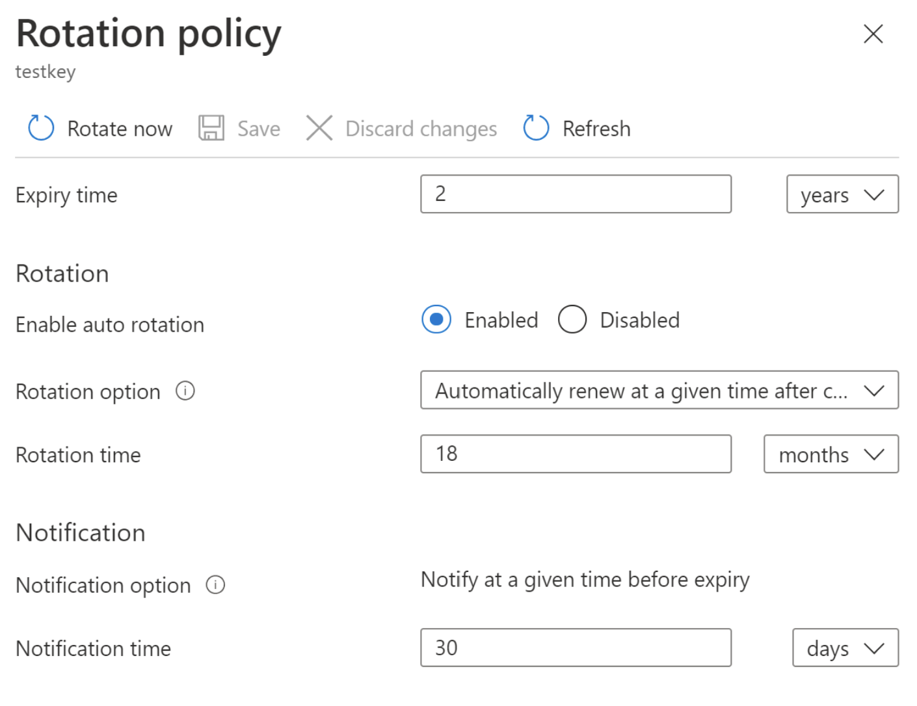
Azure Key Vault – Key Rotation Policies
Provides the customer with the ability to automatically rotate keys at a customer-specified interval
Generates a new key version when the key is rotates
Supports configuration on a per-key basis
Notes:
Key Rotation Policies documentation - https://learn.microsoft.com/en-us/azure/key-vault/keys/how-to-configure-key-rotation
Details on Microsoft rotation of keys can be found in SOC 2 Type 2 for Azure in Service Trust Portal

Slide 13
Azure Key Vault – Pricing
Variable cost per number of transactions on each Key Vault object (secrets, certificate, key)
Fixed monthly cost per key
Fixed monthly cost per key rotation
Notes:
Azure Key Vault pricing - https://azure.microsoft.com/en-us/pricing/details/key-vault/
There will eventually be a cost for managed Azure Storage account key rotations which is currently in preview as of 3/7/2023

Slide 14
Azure Key Vault – Design Considerations
Centralizing instances of Azure Key Vault is not recommended will create large security blast radius and issues with API throttling
Individual Azure Key Vault instances per workload is recommended and will create smaller blast radius and mitigate the risk of API throttling
Azure Key Vault supports both Azure RBAC and local Access Policies for authorization for data-plane operations. Azure RBAC will be easier to manage and audit and is recommended for data-plane authorization.
Azure Key Vault supports diagnostic logging which includes audit logs around object access. It is recommended to enable these logs.
Azure Key Vault supports Private Endpoints. It is recommended to enable Private Endpoints for Azure Key Vault instances where possible to reduce the network attack surface.
Ensure key rotation of CMKs is aligned with your organizational security policy. It is recommended to configure a key rotation policies to enforce rotation.
Ensure customer applications are designed to support rotation of keys stored in Key Vault
Be wary of relying on the built-in availability capabilities of Azure Key Vault for regional failures as there is no SLA on when the instance in the second region would become available to you. This could be impactful to an RTO and RPO. You should consider deploying a Key Vault per regions and using the backup and restore feature of Key Vault to move secrets, keys, or certificates between regions or simply use separate keys per region.
Notes:
Azure Key Rotation Policies info about custom application (https://learn.microsoft.com/en-us/azure/key-vault/keys/how-to-configure-key-rotation#key-rotation-policy). These applications should be configured to hit Key Vault with versionless URI and should store metadata about which version of the key was used to encrypt data so the data can be decrypted if the key is rotated. Event Grid can be monitored for the rotation.

Slide 15
Azure Storage Encryption – Encryption Support
All Azure Storage Accounts are encrypted by default with a PMK and can optionally be encrypted with a CMK stored in Azure Key Vault
Server-side encryption support for blobs, files, disks, queues, and tables
Client-side encryption support for blobs
Double-encryption supported where data is encrypted at the service layer and infrastructure layer with different algorithms and keys
Blobs support encryption scopes which allow the use of separate encryption keys for a specific container or blob to create security boundaries within a single Azure Storage Account
Notes:
All objects in storage account are encrypted including object metadata
Tables and Queues will use a PMK unless the customer specifies a CMK for queues and tables at creation (https://learn.microsoft.com/en-us/azure/storage/common/account-encryption-key-create?toc=%2Fazure%2Fstorage%2Fqueues%2Ftoc.json&tabs=portal)
CSE for blobs (https://learn.microsoft.com/en-us/azure/storage/blobs/encryption-customer-provided-keys)
Blob Encryption Scopes (https://learn.microsoft.com/en-us/azure/storage/blobs/encryption-scope-overview)
Double encryption is not supported for Ultra Disks or Premium SSD v2 disks

Slide 16
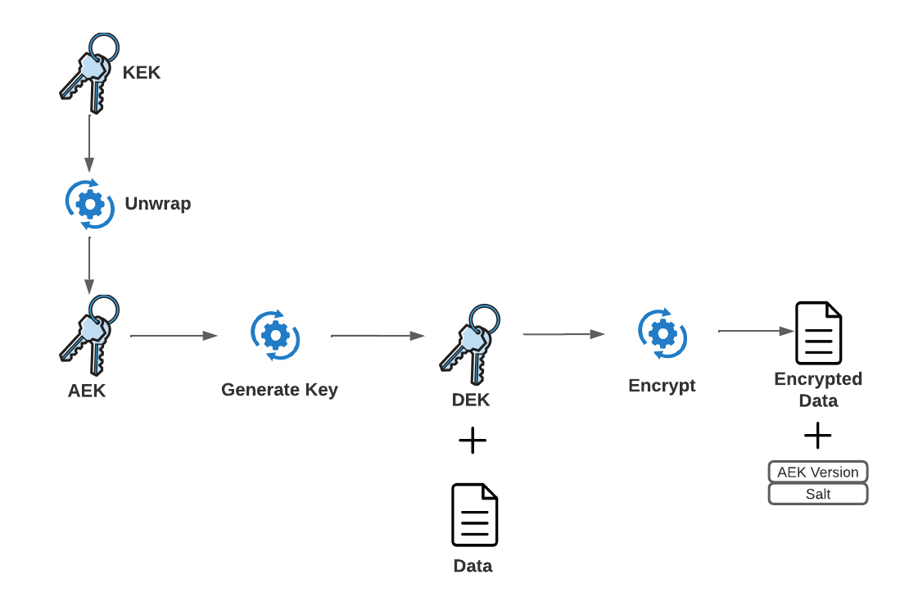
Azure Storage Encryption – SSE Process
Notes:
KEK is either PMK or CMK and if CMK is stored in customer-managed Azure Key Vault instance
Video overview of process - https://www.youtube.com/watch?v=HW81DZIpxNA (at around 1h)

Slide 17
Virtual Machine Encryption - Terminology
Managed Disk
Block-level storage volume for use with Azure Virtual Machines
Disk Encryption Set (DES)
Resource that associates a managed disk with a managed identity and CMK stored in Azure Key Vault
Host-Based Encryption (HBE)
Encryption of cached managed disks on physical host
Notes:
HBE requires customers enable the feature on their subscriptions - https://learn.microsoft.com/en-us/azure/virtual-machines/windows/disks-enable-host-based-encryption-powershell#prerequisites

Slide 18
Azure Virtual Machine Encryption – Azure Disk Encryption (ADE)
Key Facts
BitLocker feature of Windows and DM-Crypt in Linux
AES 256-bit DEK stored in Key Vault and optionally wrapped with KEK
VM uses system-assigned managed identity to access DEK in Key Vault
Benefits
End to end encryption
OS, Data, Temp Disks all can be encrypted
Considerations
Encryption engine is the OS so requires OS resources
Requires VM extension
No support for custom Linux VM images

Slide 19
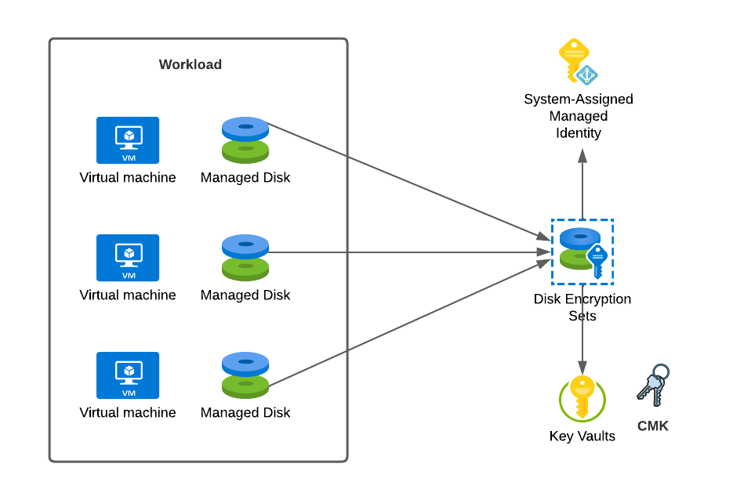
Azure Virtual Machine Encryption – SSE with CMK and HBE
Key Facts
CMK (KEK) is stored in Azure Key Vault and accessed by a system-assigned managed identity associated with the Disk Encryption Set
HBE provides end-to-end encryption protecting disks cached on the physical host and when the disks are transferred between the physical hosts and Azure Storage Account
Benefits
Encryption engine is outside of operating system
Not limited to a specific image on the VM
No VM extension required
Supports PMK and CMK
Supports automatic rotation of key used to encrypt managed disk
Considerations
OS and Data disks can use CMK but temporary uses PMK so if you need CMK across the board, you need to use ADE right now
No support for Ultra disks or Premium SSD v2
Notes:
KEK is CMK stored in Azure Key Vault
ADE and SSE with CMK and HBE cannot be used together
HBE documentation (https://learn.microsoft.com/en-us/azure/virtual-machines/disk-encryption#encryption-at-host---end-to-end-encryption-for-your-vm-data)
DES, VM, Disks, Snapshots must be within same subscription but

Slide 20
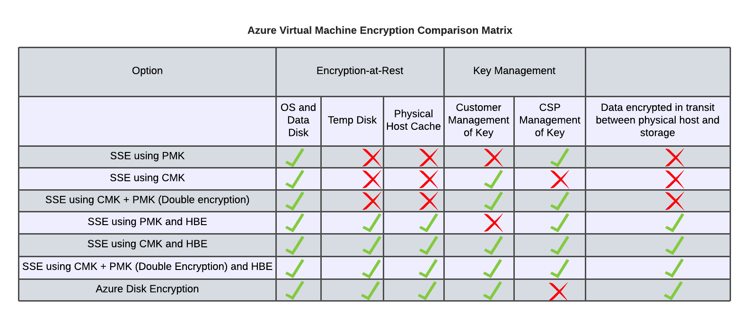
Azure Virtual Machine Encryption – Comparison Matrix

Slide 21
Azure Virtual Machine Encryption – Design Considerations
It is recommended to use SSE with HBE where possible because it does not introduce overhead to the VM and supports all custom images
It is recommended that each workload use its own Azure Key Vault instances for storage of keys used for VM encryption
It is recommended to enable automatic key rotation and to configure a policy that aligns with organizational requirements
At a minimum it is recommended that each application use a unique Disk Encryption Set but the customer can optionally use unique Disk Encryption Sets for each application tier to establish separate lifecycles for the resources
The Disk Encryption Set, VM, images, and disks must be within the same subscription but the Key Vault can be within a different subscription or tenant*
ADE should only be used if CMKs are required for all disks (including temporary and ephemeral)
Managed Disks currently or previously encrypted with ADE cannot be encrypted with SSE with CMK
* Support for cross tenant Key Vault is preview as of 3/2023

Slide 22
Azure Virtual Machine Encryption – Design Considerations
HBE does not support Ultra Disks or Premium SSD v2 Disks
Double Encryption does not support Ultra Disks or Premium SSD v2 Disks
* Support for cross tenant Key Vault is preview as of 3/2023
Notes:
Premium SSD v2 GA announcement - https://techcommunity.microsoft.com/t5/azure-storage-blog/azure-premium-ssd-v2-disk-storage-general-availability/ba-p/3649038
Premium SSD v2 is recommended for workloads requiring sub-millisecond latency and IO-intensive workloads (up to 80,000 IOPS, 1,200MB/s throughput with base of 3,000 IOPS and 125MB/s throughput vs v1 which supports up to 30,000 IOPS and 1,000MB/s

